Slide 1
CIS8695 Managing Big Data Analytics
Nasim Mousavi
Assistant Professor
J. Mack Robinson College of Business
Georgia State University
nmousavi@gsu.edu

Slide 2
Cluster Analysis

Slide 3
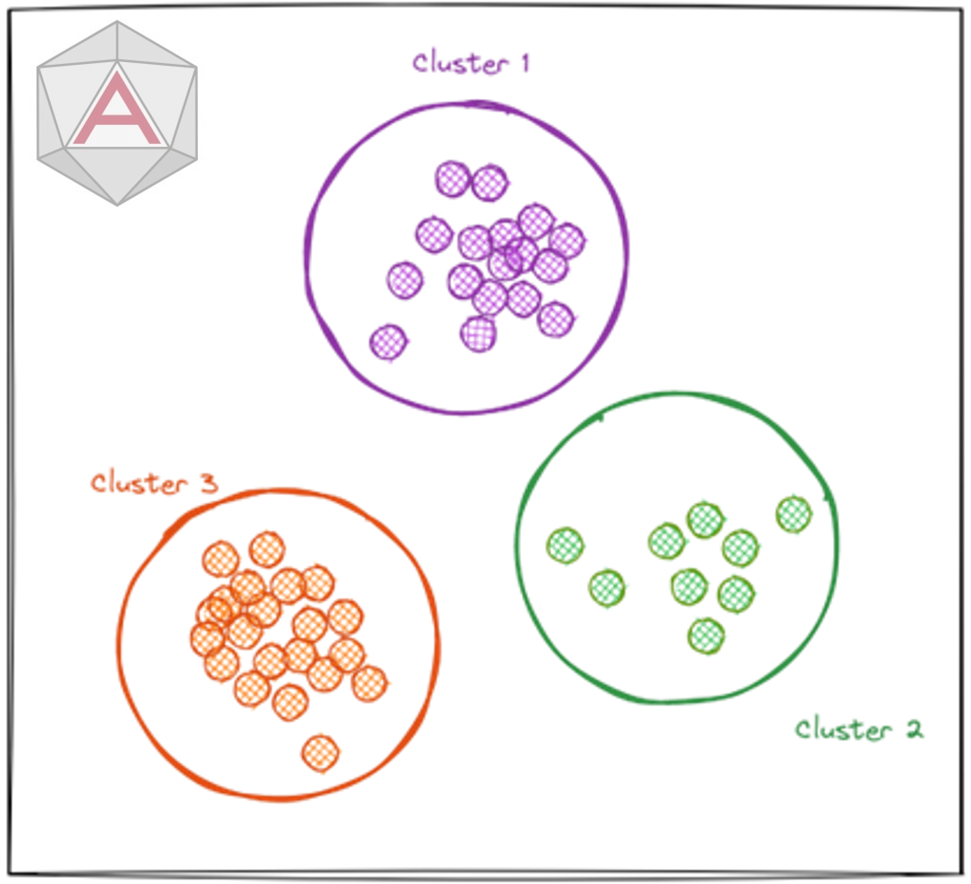
Clustering: The Main Idea
“Unsupervised” learning technique
Goal: Form groups (clusters) of similar records
Segment data points into homogeneous and meaningful clusters

Slide 4
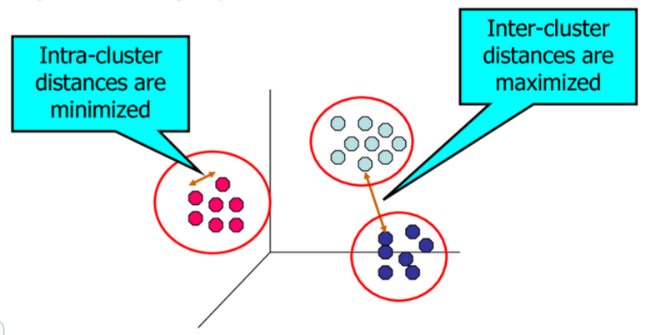
Clustering: The Main Idea
Desired properties of clustering result:
High intra-cluster similarity, low inter-cluster similarity

Slide 5
Using Clustering
Helps to gain insights into your data
Instead of trying to look at the entire dataset, you can inspect the representative clusters
Many applications
Market segmentation, medical diagnostics, bioinformatics, text mining / information retrieval, etc.

Slide 6
Example: Public Utilities
Goal: based on the information about different public utility companies, find clusters/groups of similar utilities
Data: 22 firms, 8 variables
Fixed-charge covering ratio
Rate of return on capital
Cost per kilowatt capacity
Annual load factor
Growth in peak demand
Sales
% nuclear
Fuel costs per kwh

Slide 8
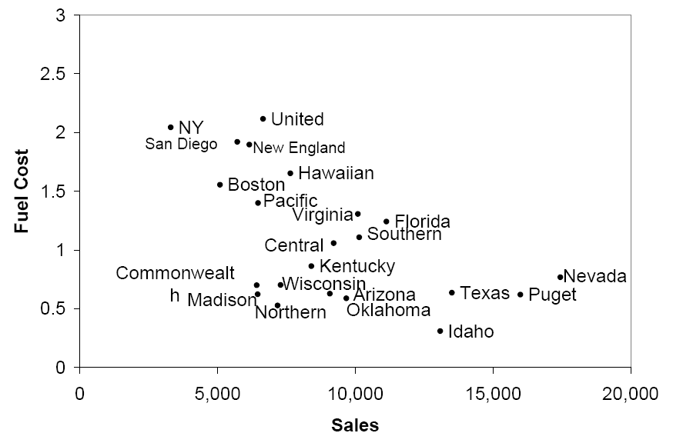
Example
For example, if we consider only sales & fuel cost:
3 rough clusters can be seen
High fuel cost, low sales
Low fuel cost, high sales
Low fuel cost, low sales

Slide 9
Things to Think About: General Issues
Similarity metrics are important for clustering
Maximize intra-cluster similarity (“tight” cluster)
Minimize inter-cluster similarity (“distinct” cluster)
But what kind of similarity to use?
Stopping criteria
How many clusters should you have?
Clustering algorithms and their parameters
How to come up the clusters?

Slide 10
Distance Metric
A key component of most clustering techniques is the distance metric
Therefore, the choice of a metric is important
Distance between two points
Distance between clusters

Slide 11
Distance Measurement
Euclidean distance is the most popular measurement
It is highly influenced by the scale of each variable
Normalize the variables
Subtract mean, divide by std. deviation

Slide 12
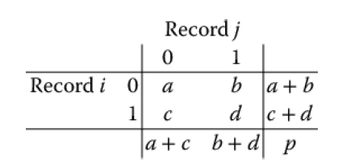
Distance for Categorical Data
To measure the distance between records in terms of two categorical variables, create table with counts:
Similarity metrics based on this table:
Matching coef. = (a+d)/p
Jaquard’s coef. = d/(b+c+d)
This coefficient ignores zero matches (0)
This is desirable when we do not want to consider two observations to be similar simply because many characteristics are absent in both

Slide 13
Other Distance Measurement
Correlation-based similarity
Statistical distance (Mahalanobis)
Manhattan distance (absolute differences)
Maximum coordinate distance
Gower’s similarity (for mixed variable types: continuous & categorical)

Slide 14
Distance Between Clusters
A cluster is a set of one or more records
The most widely used measures are
Minimum distance (distance between the two closest points in each cluster)
Maximum distance (distance between the two farthest points in each cluster)
Average distance (the average distance of all possible distances between records of each cluster)
Centroid distance (distance between the two clusters’ centroids)

Slide 15
Distance Between Clusters
C1
C1
C1
C2
C2
C2
Single linkage
(minimum pairwise distance between points from two different clusters)
Complete linkage
(maximum pairwise distance between points from two different clusters)
Average linkage
(average pairwise distance between points from two different clusters)

Slide 16
Two Popular Clustering Approaches
Hierarchical clustering
Observations are sequentially grouped to create clusters
Based on distances between observations and distances between clusters
K-means clustering (Nonhierarchical method)
Observations are allocated to a pre-specified set of clusters
Based on their distance from each cluster
Less computationally intensive and preferred for very large datasets

Slide 17
Hierarchical Clustering

Slide 18
Hierarchical Methods
Agglomerative (Bottom-Up)
Start with one cluster per data point
Merge two nearest clusters
criteria: min, max, avg distance
Repeat until only one cluster left
Output Dendrogram

Slide 19
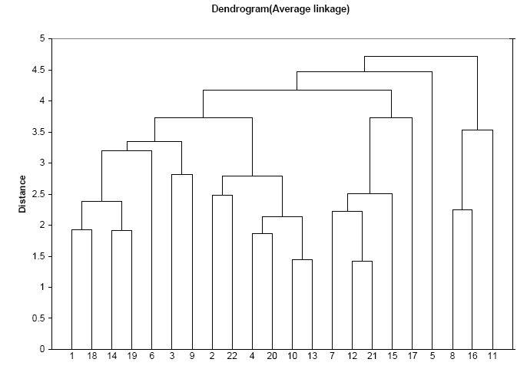
Reading the Dendrogram
See process of clustering: Lines connected lower down are merged earlier
10 and 13 will be merged next, after 12 & 21

Slide 20
Reading the Dendrogram
Determining number of clusters: For a given “distance between clusters”, a horizontal line intersects the clusters, to create clusters
E.g., at distance of 4.6 (red line in next slide), data can be reduced to 2 clusters.

Slide 22
Reading the Dendrogram
Determining number of clusters: For a given “distance between clusters”, a horizontal line intersects the clusters, to create clusters
At distance of 3.6 (green line) data can be reduced to 6 clusters.

Slide 24
Hierarchical Clustering
Advantages
Does not require prespecify number of clusters
Dendrogram represents the cluster process and results in an intuitive way
Limitations
Slow & computational expensive
Need to compute n x n distance matrix
Low stability
Easily affected by reordering data or dropped cases
Sensitive to outliers

Slide 25
K-Means Clustering

Slide 26
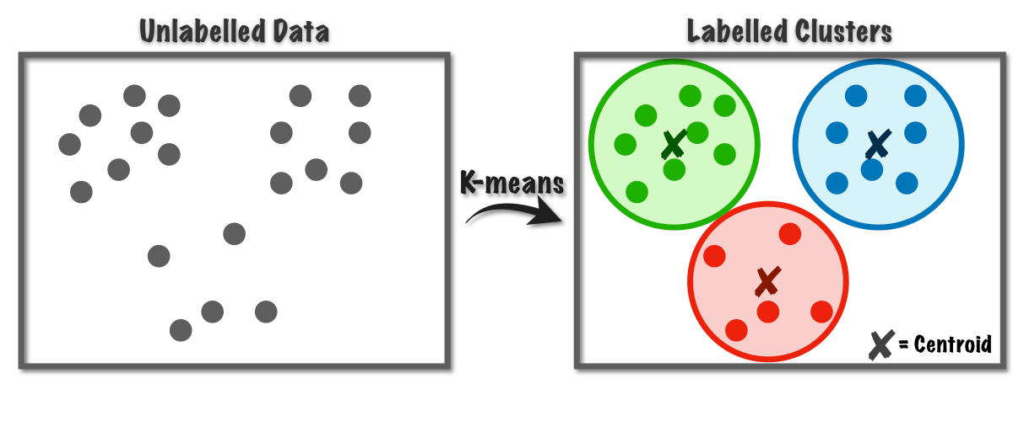
K-Means Clustering Algorithm
Number of clusters, K, must be specified
Each cluster is associated with a centroid (center point)
Each point is assigned to the cluster with the closest centroid
The objective is to minimize the sum of distances of the points to their respective centroid

Slide 27
K-Means Clustering Algorithm
Prespecify the desired # of clusters, k
Start with a partition into k clusters
Often based on random selection of k centroids
At each step, move each record to cluster with closest centroid
Recompute centroids, repeat step 3
Stop when moving records increases within-cluster dispersion

Slide 28
How Do We Find the Centroid?
Initial centroids are often chosen randomly
Clusters produced vary from one run to another
Do multiple runs and select the clustering with the smallest error

Slide 29
The Importance of Initial Centroids

Slide 30
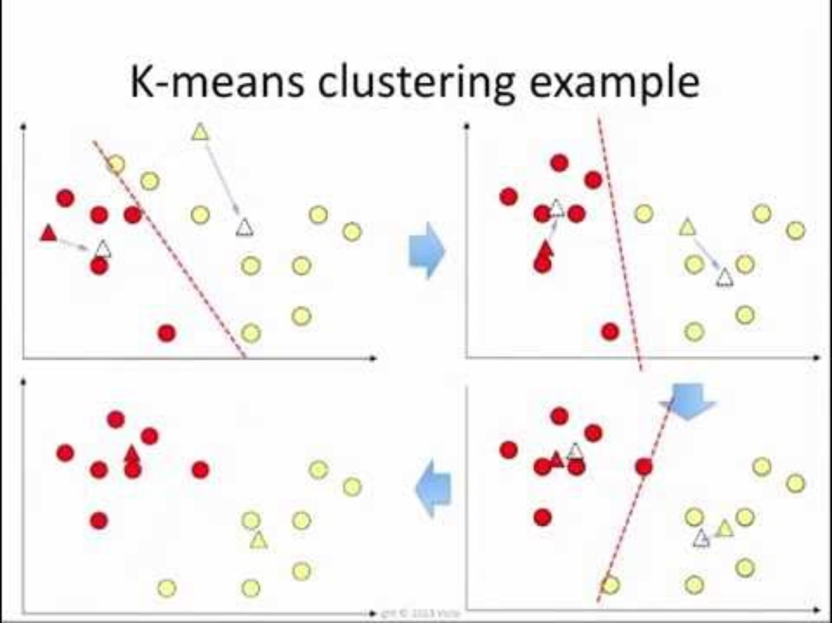
K-means Demo
Notes:
https://www.youtube.com/watch?v=_aWzGGNrcic#t=375

Slide 31
Pre-process to Get Good Centroids
Get the data ready for analysis
Deal with missing values
Address any measurement error
Rescale (e.g., Normalize) the Data
Reduces dispersion of data points by re-computing the distance
Preserves differences while dampening the effect of the outliers
Remove Outliers
Reduces dispersion of data points by removing atypical data
They don’t represent the population anyway
Big field of study now in data mining (has applications for fraud detection, discovery of blockbuster drugs in pharmaceuticals)

Slide 32
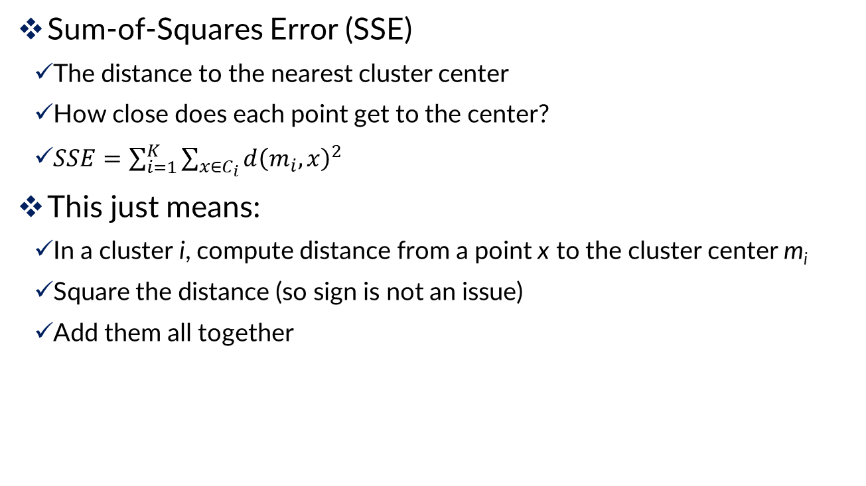
Evaluating K-means Cluster Results
Sum-of-Squares Error (SSE)
The distance to the nearest cluster center
How close does each point get to the center?
$SSE=\sum_{i=1}^{K}{\sum_{x∈C_{i}}{d{\left(m_{i},x\right)}^{2}}}$
This just means:
In a cluster i, compute distance from a point x to the cluster center m_{i}
Square the distance (so sign is not an issue)
Add them all together

Slide 33
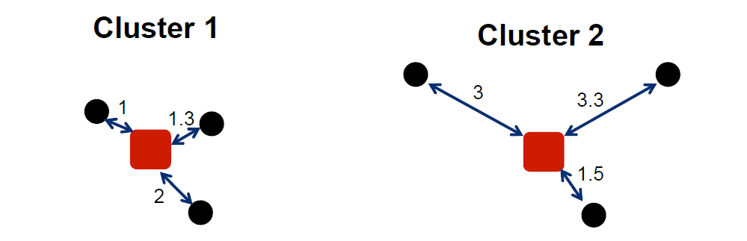
Example: Evaluating Clusters
SSE₁ = 1² + 1.3² + 2²
= 1 + 1.69 + 4
= 6.69
SSE₂ = 3² + 3.3² + 1.5²
= 9 + 10.89 + 2.25
= 22.14
Lower individual cluster SSE = a better cluster (more Cohesion)
Lower total SSE = a better set of clusters
More clusters?
Notes:
More clusters will of course reduce overall SSE

Slide 34
Distance Between Clusters
Clusters 1 and 2 are relatively well-separated from each other, while cluster 3 not as much

Slide 35
Within-Cluster Dispersion
Clusters 1 and 2 are relatively tight, cluster 3 very loose
Conclusion: Clusters 1 & 2 well defined, not so for cluster 3
Next step: try again with k=2 or k=4

Slide 36
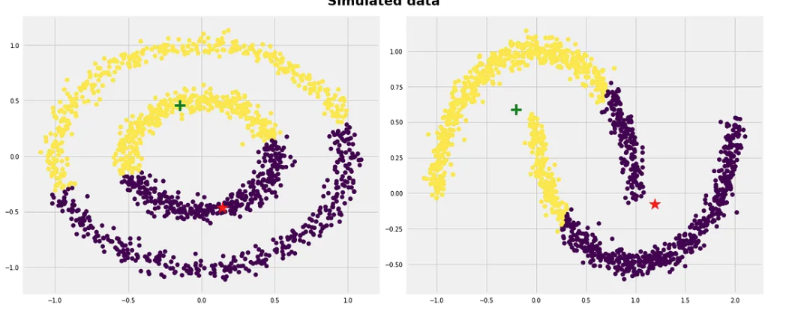
Limitations of k-Means Clustering
K-Means gives unreliable results when…
Clusters vary widely in size
Clusters vary widely in density
Clusters are not in rounded shapes

Slide 37
Limitations of k-Means Clustering
K-Means gives unreliable results when…
Clusters vary widely in size
Clusters vary widely in density
Clusters are not in rounded shapes
The data set has a lot of outliers
In these cases
The clusters may never make sense
Either the data is not suitable for clustering
Or different clustering technique should be used

